Slide 1

The Scope and Impact of Open Source Software as Intangible Capital:
A Framework for Measurement with an Application Based on the use of R Packages
Carol A. Robbins*(1), Gizem Korkmaz (2), José Bayoán Santiago Calderón (3),
Daniel Chen (2), Aaron Schroeder (2), Claire Kelling (4), Stephanie Shipp (2), Sallie Keller (2)
CRIW Conference: Big Data for 21st Century Economic Statistics
Bethesda, MD
Washington, D.C.
March 15-16, 2019
1) National Center for Science and Engineering Statistics, National Science Foundation ; 2) Social & Decision Analytics Division, Biocomplexity Institute & Initiative, University of Virginia; 3) Claremont Graduate University; 4) Pennsylvania State University
The views expressed in this paper are those of the authors and not necessarily those of their respective institutions.
Notes:
Thank you. Brian
The work I’m describing today is the output of a research team on that directs skills in data science and public policy with the long term agenda of the US Federal Statistical agency where I work, the National Center for Science and Engineering Statistics.
We are interested in measuring inputs and outputs of the S&E enterprise. As many of the outputs are knowledge and knowledge products, we may be able to measure inputs in dollars, but market measurements alone are not going to cut it to fully understand output and impact.
Thus, I am going to talk about resource costs, and then talk about impacts, and those impacts are not measured in dollars. the statistics and indicators for understanding the US S&E enterprise in a global context. Software is a form of stored and shared knowledge that is on of the outputs of that global enterprise.
We see OSS as a subset of intangible capital, digital tools created with resources diverted from current consumption to produce future benefits. Market measures do not fully account for these tools, and for tools that are shared freely, we are going to need a different set of measures. Using information we gather from the OSS programs themselves and from the websites where the programs are shared, estimate resource cost, in dollars. , and impact, not in dollars, but terms of usage by other software.

Slide 2

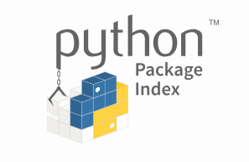

Measuring Open Source Software
Why:
Long-lasting benefits, zero purchase cost, creates new products
Public goods qualities, output of public as well as private spending
How:
  Access detailed data about these new products and tools from repositories:
  Develop framework for measuring cost
$2017
Notes:
Open source software is computer software that can be freely accessed, used, changed, and shared by anyone. Proprietary software, by contrast, has code that is generally not accessible for modification, and licensing or purchase fees are often charged.
U.S. tech companies are interested, Microsoft recently purchased Github, a popular OSS repository, and IBM purchased Redhat, a distributor of Linnux. distributor,
Apache is open source server software developed with federal and state funds at the National Center for Supercomputing Applications (in Illinois). Today you can download it for free or alternatively, you could purchase proprietary Microsoft server software for around $1000. Many go with Apache -- currently on more than half of the world’s busiest websites. Researchers Shane Greenstein and Frank Nagle have estimated that it would cost between $2 and $10 billion dollars to replace these Apache servers with proprietary Microsoft software.
Substantial contributions are international. Linux, developed originally by a student at the University of Helsinki, R, University of Auckland in New Zealand R does much of the widely used statistical programming software packages, SAS and Stata, can do, without the per user license cost of several thousand dollars.
In addition to being widely used, both by businesses and others, these three examples of open source software share another feature as well. They were originally developed outside of the private sector, in universities and in government supported facilities.
Here is what we do
Our usage measure is akin to that used for other knowledge products, I’’ use two examples to illustrate the work. OSS created with US Federal funding, and then four OSS languages: R, Julia, Javascript, and Python. We have a bottom up method we think is scalable, and I’m sharing that method and early results today.

Slide 3
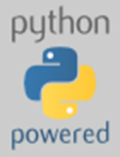

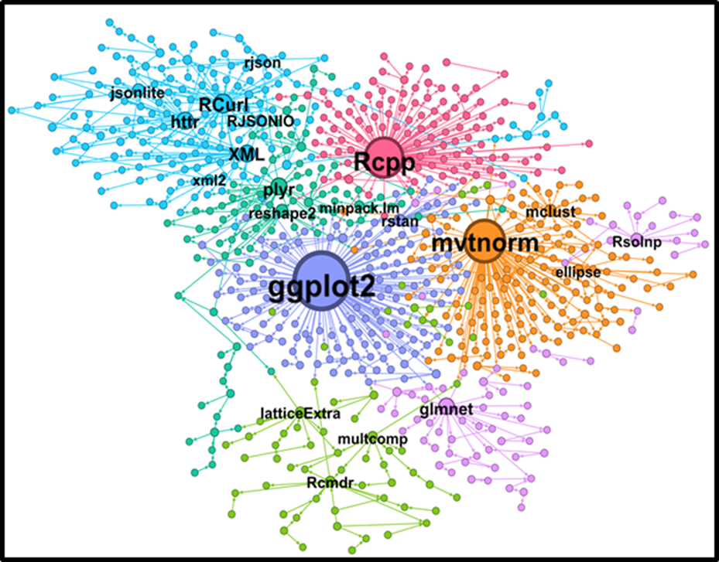
Measuring Open Source Software
How (continued):
  Estimate resource cost for two languages
  Use Network Analysis and Downloads to show impact
Notes:
Changes in BEA’s GDP accounts come in three flavors, definitional, methodological, and source data.
Our work does not propose or imply any change the definition of Investment in BEA’s GDP accounts. It’s value for GDP measurement is in the use of alternative methodology and source data that focuses on a subset of an investment category in the national economics accounts. The bottom -up method we use may reveal some currently unaccounted-for software investment—I think that will happen, and so BEA may be interested.
However, the main goal of the project is to improve our measurement knowledge products, include products created and exchange both within and outside of the market. This is a pretty interesting topic in and of itself, and for my agency, NCSES, it will help us provide better indicators of the US S&E enterprise in a global context, as well as highlight the role of public spending in producing useful knowledge products.

Slide 4
U.S. Software Investment in 2017: $381 Billion
Components of Software Investment |  |  | Private Sector total in billions $352.9* | Public Sector total in billions $38.4
Prepackaged |  |  | $147.6 | State and Local $17.7 | Federal $10.7
 |  |  | $141.1
Custom
Own-account |  |  | 64.3
Source: BEA. Intellectual Property Products Fixed Asset Tables (private) and Investment in Government Fixed Assets (Table 7.5B).
* Difference between total and sum is a rounding error.
Notes:
The BEA has been including long-lasting software as investment, since1999 and has a well-established methodology that is widely used by many nations.
BEA reports that private investment in software in 2018 was $352.9 billion dollars, composed of $147.6 billion in prepackaged software, $141.1 billion for custom software and $64.3 billion dollars for own-account software.
Government investment for 2017 are not yet available from BEA, however, for 2016 Government investment in software was $10.7 billion dollars for Federal and $10.7 billion dollars for State and Local, the category that includes investments by public universities (BEA, 2017.)
Overall software accounts for about 381 billion dollars a year in fixed investment. Conceptually, this amount includes software purchased or created inhouse but excludes software acquired for free from others.
It is measured based on in-house expenditures for its creation.
So, where in this figure open source software? As I understand it, software created inhouse that is used internally, without respect to whether or not the creator has shared it with others as open source. Rresources shift from consumption to creating something that provides value in use over a long period of time to its creator.
In these cases, open source software is a component of own account software. That would put it here [click] in this figure.
Coming back to public investment, that means that open source software, created in public universities and government labs belong here in State and Local Investment, and here in Federal investment. Private university created open source software would be within the private estimates, as would any created by private nonprofit institutions.
And OSS created in foreign universities, like R or Linnux, would originally be created in an “rest of the world” category.
Right hand side
BEA’s software subcategories are prepackaged, custom, and own account
BEA’s economic sectors are private and public, with breakdowns.
Gray columns are outside of the national accounts –household sector and ROW—here we are stepping outside of the “box”
Our view is that Custom and Own-account can be further subdivided into proprietary and OSS, and that by doing it, we can identify and begin to separately count OSS, along with its source, based on funding.
We imagine this table filled out, and suggest using resource cost as the measure. This corresponds to the way that BEA and the SNA recommend measuring own account investment
This cost estimation applied to 4 open source languages, where the packages and metadata were collected from Github.
Coming back to public investment, that means that open source software, like Apache, created in public universities and government labs belong here in State and Local Investment, and here in Federal investment. Private university created open source software would be within the private estimates, as would any created by private nonprofit institutions.

Slide 5
A Small Tweak to Standard Software Investment Categories can highlight OSS
Components of Software Investment |  |  | Private Sector |  |  |  |  | Public Sector |  |  | Household Sector | Rest of World
 |  |  | Business | Other private nonprofits |  |  | Higher education | Higher education | Federal Government and FFRDCs | Non-federal government, ex. Higher Ed.
Prepackaged
Custom
Proprietary
Open Source (OSS)
Own-account
Proprietary
Open Source (OSS)
Notes:
Right hand side
BEA’s software subcategories are prepackaged, custom, and own account
BEA’s economic sectors are private and public, with breakdowns.
Changes in BEA’s GDP accounts come in three flavors, definitional, methodological, and source data.
Our work does not propose or imply any change the definition of Investment in BEA’s GDP accounts. It’s value for GDP measurement is in the use of alternative methodology and source data that focuses on a subset of an investment category in the national economics accounts. The bottom -up method we use may reveal some currently unaccounted-for software investment—I think that will happen, and so BEA may be interested.
However, the main goal of the project is to improve our measurement knowledge products, include products created and exchange both within and outside of the market. This is a pretty interesting topic in and of itself, and for my agency, NCSES, it will help us provide better indicators of the US S&E enterprise in a global context, as well as highlight the role of public spending in producing useful knowledge products.
Gray columns are outside of the national accounts –household sector and ROW—here we are stepping outside of the “box”
Our view is that Custom and Own-account can be further subdivided into proprietary and OSS, and that by doing it, we can identify and begin to separately count OSS, along with its source, based on funding.
We imagine this table filled out, and suggest using resource cost as the measure. This corresponds to the way that BEA and the SNA recommend measuring own account investment
This cost estimation applied to 4 open source languages, where the packages and metadata were collected from Github.
Coming back to public investment, that means that open source software, like Apache, created in public universities and government labs belong here in State and Local Investment, and here in Federal investment. Private university created open source software would be within the private estimates, as would any created by private nonprofit institutions.

Slide 6
“Big Data” sources for OSS measurement
Registry contains:
  Basic package information
  Package manifest file
CRAN
PyPI
Code.gov
Source Code Hosting Platform contains:
  Author(s), Maintainers
  Version
  License
GitHub
Notes:
Right hand side
BEA’s software subcategories are prepackaged, custom, and own account
BEA’s economic sectors are private and public, with breakdowns.
Changes in BEA’s GDP accounts come in three flavors, definitional, methodological, and source data.
Our work does not propose or imply any change the definition of Investment in BEA’s GDP accounts. It’s value for GDP measurement is in the use of alternative methodology and source data that focuses on a subset of an investment category in the national economics accounts. The bottom -up method we use may reveal some currently unaccounted-for software investment—I think that will happen, and so BEA may be interested.
However, the main goal of the project is to improve our measurement knowledge products, include products created and exchange both within and outside of the market. This is a pretty interesting topic in and of itself, and for my agency, NCSES, it will help us provide better indicators of the US S&E enterprise in a global context, as well as highlight the role of public spending in producing useful knowledge products.
Gray columns are outside of the national accounts –household sector and ROW—here we are stepping outside of the “box”
Our view is that Custom and Own-account can be further subdivided into proprietary and OSS, and that by doing it, we can identify and begin to separately count OSS, along with its source, based on funding.
We imagine this table filled out, and suggest using resource cost as the measure. This corresponds to the way that BEA and the SNA recommend measuring own account investment
This cost estimation applied to 4 open source languages, where the packages and metadata were collected from Github.
Coming back to public investment, that means that open source software, like Apache, created in public universities and government labs belong here in State and Local Investment, and here in Federal investment. Private university created open source software would be within the private estimates, as would any created by private nonprofit institutions.

Slide 7

GitHub Platform
Language | R | Python
Package manager | CRAN | PyPI
Number of packages | 13,719 | 164,836
Production ready | 13,350 | 17,482
OSI-approved & production ready | 13,143 | 15,043
Packages on GitHub | 4,407 | 11,016
Packages on GitHub (analysis) | 4,358 | 9,773

Slide 8
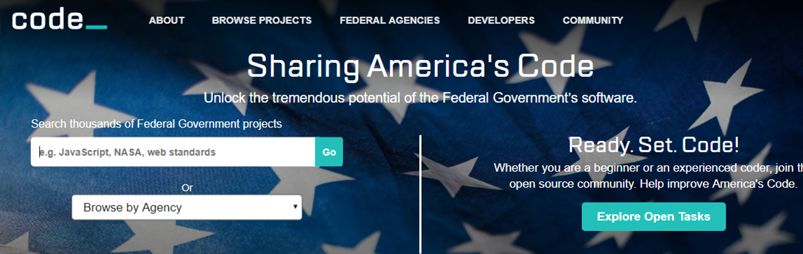
Open Source Projects by Federal Government Organization Top 5 by number of projects for projects started before January 1, 2018
Organization Name | Total Projects on Code.gov | Number of Projects Linked to Github collection | Kilo-lines of code (kloc) | Commits | Number of contributors
Total | 4,457 | 2,688 | 2,486,210 | 950,625 | 8,292
General Services Administration | 1,501 | 1,368 | 266,860 | 318,676 | 4,631
Department of Energy | 899 | 704 | 1,219,835 | 485,726 | 2,433
Consumer Financial Protection Bureau | 261 | 243 | 753,447 | 49,781 | 334
National Aeronautics and Space Administration | 998 | 141 | 179,917 | 51,936 | 358
Environmental Protection Agency | 156 | 61 | 14,327 | 4,711 | 78
Note: for projects started before January 1, 2018
Notes:
A lot of re-useable code is first created as part of the ongoing work of the Federal Government. This can happen in the performance of a Federal contract or other Government-funded activity. As of late July 2018, more than 4000 separate software code projects are shared for reuse on code.gov. The projects are shared as part of an effort to make custom-developed code broadly available across the Federal Government, including publishing as OSS when appropriate. Twenty-six Federal departments, agencies, and other entities have contributed open source code on projects that have start dates between 2009 and 2018.
Most, but not all, of these projects listed on code.gov provided links to the repository to download code. We used the applications programming interface (API) provided by code.gov to collect data on projects associated with 26 Federal government agencies. We obtained a total of 4,457 projects listed on code.gov as of July 30, 2018, and 4,051 of these projects included a URL to a code repository. These repositories include well-known ones such as Github, SourceForge, and Bitbucket, as well as webpage repositories run by units of the Federal government, such as those run by NASA and Sandia National Lab.
This slide shows the number of projects on code.gov for the Federal government. The third column shows the number of projects for each organization that included a link to a Github repository location where we obtained development information by project. We collected this detailed information on Github for 2,977 of these projects, yielding detailed data for 67% of the projects on code.gov. Limiting our analysis to those projects that started before January 1, 2018, we have data for 2,688 projects, or 60% of all projects on Code.gov. The data we collected include number of lines of code, both additions and deletions, contributors, and commits. These 2,688 projects contain 2.5 billion lines of code, represent 950,000 commits, and over 8,000 contributors.

Slide 9
Cost of OSS Software Package Creation
  Kilo-lines represent effort
    Effort is a nonlinear function of complexity and lines of code
    historical software project factors
  Estimate resource cost with wage equivalent for 2017
    Computer programmers, software developers
    Occupation Employment Survey, Bureau of Labor Statistics
  Estimate non-wage costs adapting OECD and BEA methods
Notes:
The calibration factor represents the person months needed for a set number of lines of code, unadjusted for effort factors. The effort multipliers account for complexity, reliability, and scale for these models; they lead to increased cost. In COCOMO II for example, the effort factors are based on qualitative assessments for each attribute with ratings from very low to extra high. Translating this approach to our data on OSS, the package-specific data we collected provides lines of code (added and deleted by each contributor) for each completed package. We use a well-known set of parameters and calibration factors from COCOMO II (Boehm et al. 2000) to estimate person-hours per package. The formula below shows the parameters we used, selected for the organic software class which consists of software dealing with a well-known programming language and a small, but experienced team of contributors. The model allows for these parameters to be adjusted based on additional data.

Slide 10
KLOC and Resource Cost Based on Projects in CRAN
Name | Klines | Estimated Cost in Thousands of 2017$
All packages | 100,216.787 | 1,579,689
mapdata | 2,257.20 | 1,516
hunspell | 756.9 | 980
edgarWebR | 456.8 | 801
TCGA2STAT | 376.9 | 742
igraph | 364 | 732
Notes:
The calibration factor represents the person months needed for a set number of lines of code, unadjusted for effort factors. The effort multipliers account for complexity, reliability, and scale for these models; they lead to increased cost. In COCOMO II for example, the effort factors are based on qualitative assessments for each attribute with ratings from very low to extra high. Translating this approach to our data on OSS, the package-specific data we collected provides lines of code (added and deleted by each contributor) for each completed package. We use a well-known set of parameters and calibration factors from COCOMO II (Boehm et al. 2000) to estimate person-hours per package. The formula below shows the parameters we used, selected for the organic software class which consists of software dealing with a well-known programming language and a small, but experienced team of contributors. The model allows for these parameters to be adjusted based on additional data.

Slide 11
KLOC and Resource Cost Based on GitHub KLOC
Package Name | KLOC | Estimated Cost in Thousands of 2017$
All packages | 282,167.871 | 883,209
archivist | 28488.639 | 4,169
CollessLike | 15844.721 | 3,299
readtext | 13888.309 | 3,130
ptwikiwords | 11452.965 | 2,898
nasapower | 10613.638 | 2,812
Package Name | KLOC | Estimated Cost in Thousands of 2017$
All packages | 611,601.568 | 1,560,374
libsass | 50340.53 | 5,233
py3-ortools | 37412.424 | 4,648
LSD-Bubble | 15270.398 | 3,251
IotPy | 14899.252 | 3,219
openquake.engine | 13841.578 | 3,126
out
Notes:
Network analysis provides many ways to measure the relative strength of relationships between things that are not necessarily market based.
In degrees on left,
Carol has a paper with a reference list citing three papers, including one by Wendy, in red. This is a kind of dependency, Wendy’s paper has an impact on my paper.
Outdegrees captures the opposite effect. Wendy’s paper on the right in red is cited by 3 papers, including my orange one. Wendy has had an impact on three papers.
So comparing the two on just indegree and outdegrees, Wendy’s paper has an outdegree of three dependent papers. My paper’s indegree, shown on the left, is three,,my paper “depends” on three papers.
The same ideas hold when we look at the relationships between patent citations. Carol’s patent on the left cites a lot of prior art, while Wendy’s patent on the right is subsequently cited by lots of other patents.
There are much more complex ways to use networked data to understand impact, and exploring these is one of our key goals.

Slide 12
Downloads of Base R
out
Notes:
Network analysis provides many ways to measure the relative strength of relationships between things that are not necessarily market based.
In degrees on left,
Carol has a paper with a reference list citing three papers, including one by Wendy, in red. This is a kind of dependency, Wendy’s paper has an impact on my paper.
Outdegrees captures the opposite effect. Wendy’s paper on the right in red is cited by 3 papers, including my orange one. Wendy has had an impact on three papers.
So comparing the two on just indegree and outdegrees, Wendy’s paper has an outdegree of three dependent papers. My paper’s indegree, shown on the left, is three,,my paper “depends” on three papers.
The same ideas hold when we look at the relationships between patent citations. Carol’s patent on the left cites a lot of prior art, while Wendy’s patent on the right is subsequently cited by lots of other patents.
There are much more complex ways to use networked data to understand impact, and exploring these is one of our key goals.

Slide 13
R Downloads and Reuses as Impact
Package | # Reuse
ggplot2 | 105,774
plyr | 101,596
digest | 99,774
stringr | 98,086
colorspace | 93,590
RColorBrewer | 81,448
reshape2 | 81,350
scales | 73,385
proto | 71,698
munsell | 71,483
Package | 2018 Downloads
Rcpp | 3,519,510
rlang | 2,893,889
stringi | 2,610,184
stringr | 2,511,011
ggplot2 | 2,495,315
digest | 2,453,958
glue | 2,296,688
tibble | 2,242,376
pillar | 2,222,364
yaml | 2,207,621
out
Notes:
Network analysis provides many ways to measure the relative strength of relationships between things that are not necessarily market based.
In degrees on left,
Carol has a paper with a reference list citing three papers, including one by Wendy, in red. This is a kind of dependency, Wendy’s paper has an impact on my paper.
Outdegrees captures the opposite effect. Wendy’s paper on the right in red is cited by 3 papers, including my orange one. Wendy has had an impact on three papers.
So comparing the two on just indegree and outdegrees, Wendy’s paper has an outdegree of three dependent papers. My paper’s indegree, shown on the left, is three,,my paper “depends” on three papers.
The same ideas hold when we look at the relationships between patent citations. Carol’s patent on the left cites a lot of prior art, while Wendy’s patent on the right is subsequently cited by lots of other patents.
There are much more complex ways to use networked data to understand impact, and exploring these is one of our key goals.

Slide 14
Sectors of R Contributors from CRAN
Domain | Packages | Percent | Maintainers | Percent
Total | 11,886.0 |  | 6,697
.com | 4,964 | 42% | 2,770 | 40%
.edu | 1,981 | 17% | 1,202 | 17%
.org | 481 | 4% | 184 | 3%
.net | 168 | 1% | 89 | 1%
.gov | 69 | 1% | 43 | 1%
.name | 33 | 0% | 3 | 0%
.info | 8 | 0% | 6 | 0%
.biz | 6 | 0% | 3 | 0%
.(country) | 4,124 | 35% | 2,495 | 36%
Notes:
Outdegree
Indegree
Centrality

Slide 15
Countries of R Contributors from CRAN
Domain | Packages | Percent | Maintainers | Percent
Germany (.de) | 687 | 6% | 427 | 6%
United Kingdom (.uk) | 434 | 4% | 267 | 4%
France (.fr) | 398 | 3% | 235 | 3%
Canada (.ca) | 335 | 3% | 160 | 2%
Australia (.au) | 198 | 2% | 109 | 2%
Italy (.it) | 198 | 2% | 129 | 2%
Switzerland (.ch) | 172 | 1% | 102 | 2%
Spain (.es) | 166 | 1% | 102 | 2%
Netherlands (.nl) | 151 | 1% | 89 | 1%
Austria (.at) | 123 | 0.0 | 56.0 | 1%
Notes:
Outdegree
Indegree
Centrality

Slide 16

Questions? crobbins@nsf.gov
Grateful Acknowledgement to
Team Open Source Surfers (TOSS)
Hannah Brinkley, Daniel Chen, José Bayoán Santiago Calderón, Eirik Iversen, Keren Chen, and Gizem Korkmaz

